Slide 1

AUTOCOMPOSER : AI BASED
Music Generation and Sheet generation
-By
CHIRIKI CHANDANA - 22261A1215
KANIVETA BHUVAN CHANDRA - 22261A1231
MRS.P.NAVEENA
(Internal Supervisor)

Slide 2

MAHATMA GANDHI INSTITUTE OF TECHNOLOGY(A)
DEPARTMENT OF INFORMATION TECHNOLOGY
An Industry Oriented Mini Project(IT653PC)
On
AUTOCOMPOSER
By
Chiriki Chandana - 22261A1215
Kaniveta Bhuvan Chandra - 22261A1231
Batch ID: IT-24-04
Internal Supervisor
Mrs.P.Naveena
Assistant Professor
IOMP Supervisor
Dr.U.Chaitanya
Assistant Professor

Slide 3

OUTLINE
ABSTRACT
INTRODUCTION
EXISTING SYSTEM
PROPOSED SYSTEM
APPLICATIONS
REQUIREMENTS
LITERATURE SURVERY
PROBLEM STATEMENT
OBJECTIVES
MODULES DESCRIPTION
ALGORITHM
DESIGN
CODE EXECUTION / RESULT
TEST CASES
CONCLUSION AND FUTURE ENHANCEMENT
REFERENCES
OUTLINE

Slide 4
ABSTRACT
• Automates music composition using Python and PrettyMIDI with configurable parameters like tempo, scale, rhythm, and pitch.
• Generates realistic piano-style MIDI sequences using probabilistic and rule-based methods.
• Converts MIDI to high-quality WAV audio using FluidSynth and SoundFont for expressive playback.
• Visualizes music as a piano roll using Matplotlib to show pitch, timing, and velocity dynamics.
• Creates traditional sheet music in PDF format using Music21 and LilyPond, with all outputs downloadable.

Slide 5
INTRODUCTION
The AI Music Composer project aims to make music creation more accessible by using artificial intelligence to automate the process of composing, synthesizing, visualizing, and rendering music. Traditional music composition requires years of training and multiple tools, which can be a barrier for beginners or those without access to instruments.
This system acts as a creative assistant, not a replacement for musicians. It helps users explore musical ideas, generate practice material, and understand music theory through a single, integrated platform. By combining MIDI generation, audio playback, piano roll visualization, and sheet music creation, the tool offers an end-to-end solution for both learning and composing music.

Slide 6
EXISTING SYSTEM
• Most tools rely on manual composition or preset loops, with little to no AI-driven generation.
• Limited control over musical parameters like tempo, scale, or melody in existing AI tools.
• Lack of integration—users must use separate tools for audio, visualization, and sheet music.
• Many platforms don’t provide high-quality downloadable outputs like WAV or PDF.
• No unified, user-friendly system exists for end-to-end automated music creation.

Slide 7
PROPOSED SYSTEM
• An online AI-based platform that generates original music based on user-defined parameters like tempo, scale, rhythm, and pitch.
• Uses probabilistic and rule-based methods to create unique and realistic piano-style MIDI compositions.
• Converts MIDI into high-quality WAV audio using FluidSynth and customizable SoundFonts.
• Generates piano roll visualizations and sheet music PDFs with Music21 and LilyPond.
• Provides a user-friendly web interface with audio playback and downloadable MIDI, WAV, and PDF files.

Slide 8
APPLICATIONS
•Music Education
•Creative Assistance
•Background Score Generation
•Accessible Music Creation
•Rapid Music Prototyping
•Music Therapy
•Game Soundtracks
•Film Scoring
•Meditation and Relaxation Music
•Personalized Music Generation
•Audio Branding

Slide 9
HARDWARE AND SOFTWARE REQUIREMENTS
Hardware Requirements:
•Operating System: Windows, Mac, Linux
•Processor: Intel i5 or equivalent
•RAM: Minimum 8GB
Software Requirements:
•VS Code
•Python
•PrettyMIDI
•FluidSynth
•Music21
•LilyPond
•Flask
•HTML
•CSS
•JavaScript

Slide 10
LITERATURE SURVEY
Author Names, Year | Journal / Conference Name & Publisher | Methodology / Algorithms Used | Merits | Demerits | Research Gaps
[1]Hao-Wen Dong et al., 2018 | IEEE | MuseGAN: Multi-track GAN for symbolic music generation using MIDI representations | Enables polyphonic, multi-track composition with instrument control | Lacks fine user parameter customization (tempo, scale) | Need for rule-based parameter control like scale, rhythm, arpeggios
[2] Gino Brunner et al., 2018 | IEEE Transactions on Multimedia | MIDI-VAE: Variational Autoencoder to learn musical styles and dynamics in MIDI | Enables music interpolation and instrument separation | Doesn’t offer end-to-end sheet music generation or audio synthesis | Combine MIDI generation with audio rendering and music notation
[3] Philippe Esling et al., 2020 | IEEE CEC | FlowComposer: Constraint-based symbolic composition tool with visualization | Supports structured composition and partial rule-based control | No integrated synthesis or sheet music export pipeline | Unify composition, audio playback, and score export in one pipeline
[4] Yu-Siang Huang et al., 2020 | IEEE ICASSP | Pop Music Transformer: Transformer model generating long pop music sequences | Generates realistic, expressive musical phrases with attention | Complex and opaque for real-time, user-customized interaction | Enhance transparency and customization for non-technical users.

Slide 11
PROBLEM STATEMENT
Music composition is complex and resource-intensive, especially for those without formal training or instruments. Traditional methods require deep knowledge and multiple tools for composing, audio production, and sheet music, creating barriers for learners and creators. Existing digital tools often focus on only one task, forcing users to switch between different software, which reduces efficiency and accessibility.
There is a need for a single, unified system that can automatically generate music, synthesize audio, visualize compositions, and create sheet music. The AI Music Composer project fulfills this by integrating all these features into one Python-based platform, making music creation easier and more accessible for everyone.

Slide 12
OBJECTIVES
Generate unique and creative musical compositions each time.
Let users customize tempo, scale, pitch, rhythm, and arpeggios.
Provide high-quality downloadable WAV audio files.
Automatically create traditional sheet music PDFs.

Slide 13
MODULES
1.User Interaction Module
Collects user inputs (tempo, scale, rhythm, etc.) and displays generated music with playback and download options.
2.MIDI Generation Module
Creates MIDI music based on user parameters using rule-based and probabilistic models.
3.Audio Synthesis Module
Converts MIDI into high-quality WAV audio using FluidSynth and SoundFonts.
4.Sheet Music Generation Module
Transforms MIDI into printable sheet music PDFs using Music21 and LilyPond.
5.Visualization Module
Shows piano roll or rhythm charts for visualizing the music’s structure and dynamics.

Slide 14
METHODOLOGY
The system follows a 4-step algorithmic pipeline:
Input Collection – Accepts user-defined musical parameters.
MIDI Generation – Creates symbolic music data based on rules and randomness.
Audio & Visual Rendering – Converts MIDI to sound and visual format.
Sheet Music Creation – Converts MIDI into printable music notation.
It combines rule-based logic with probabilistic variations to generate diverse and musically coherent outputs without requiring any pre-trained model.

Slide 15
MIDI Generation Module
Uses algorithms to create note sequences matching user-selected musical attributes.
Melodies are generated based on rules like:
Notes must belong to the selected scale
Arpeggios and rhythmic patterns are added probabilistically
Pitch jumps are smoothed if melody bias is enabled
Audio Synthesis Module
The generated MIDI is passed to FluidSynth, which uses SoundFonts to synthesize lifelike piano audio.
Outputs a WAV file that mimics a real piano performance.
Benefits: No need for manual playback tools; users get downloadable, high-quality sound.

Slide 16
Piano Roll Visualization
Generated using Matplotlib
X-axis: Time
Y-axis: Pitch
Colors: Note velocity (intensity/loudness)
Helps users visually analyze timing, pitch flow, and dynamics of the melody
Sheet Music Generation Module
Uses Music21 to parse MIDI and format it for LilyPond
LilyPond renders a professional-grade PDF sheet music file
Enables musicians to print and perform the generated music
Also useful for music educators and learners studying notation

Slide 17
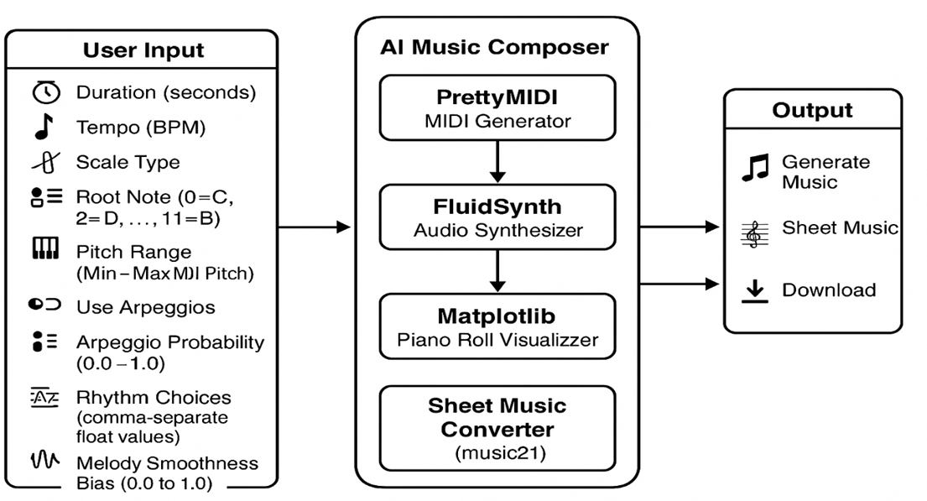
ARCHITECTURE

Slide 18
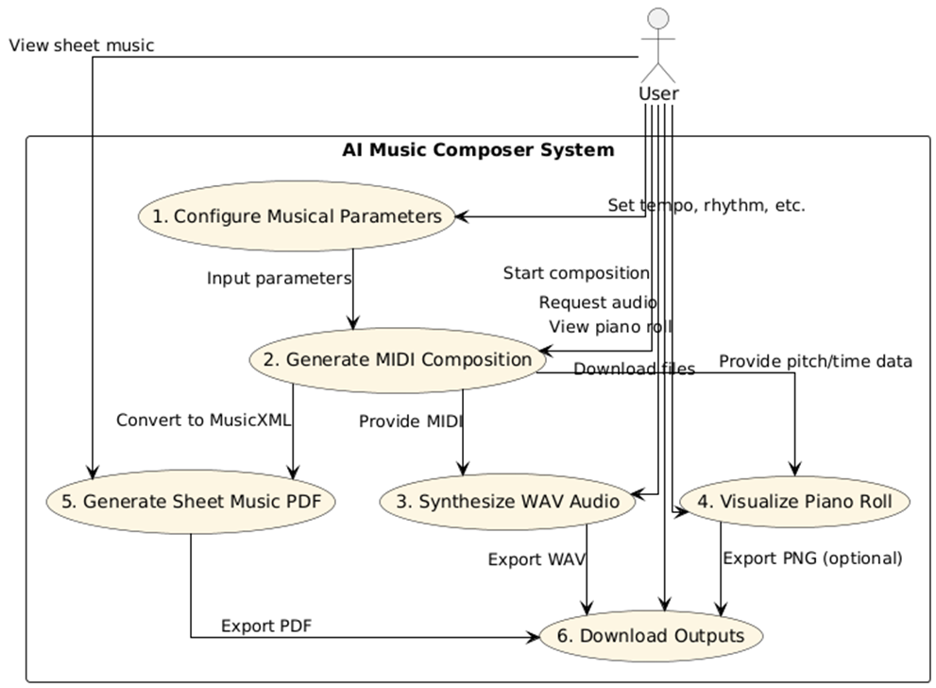
USE CASE DIAGRAM

Slide 19
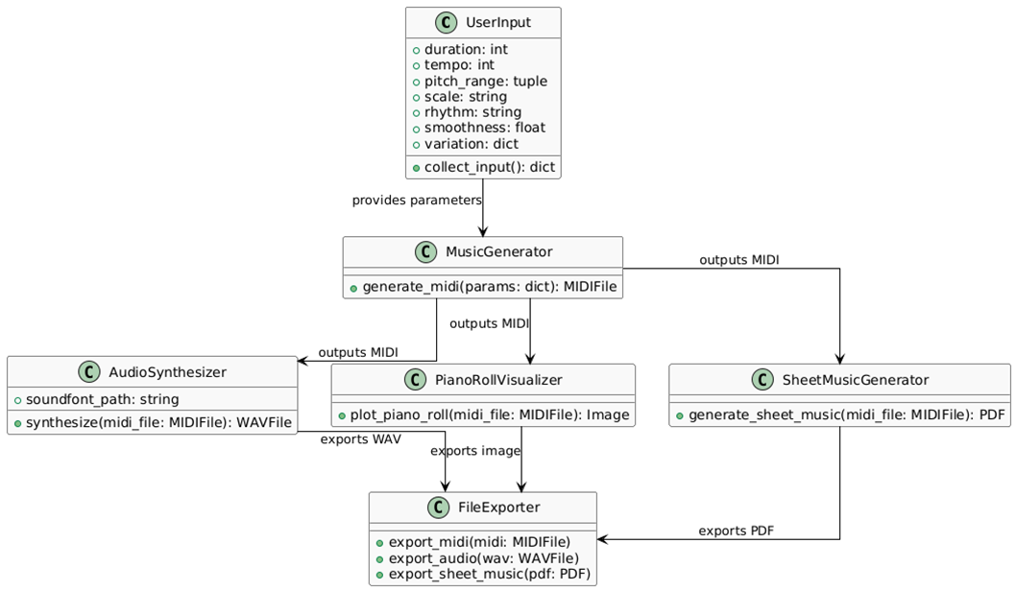
CLASS DIAGRAM

Slide 20
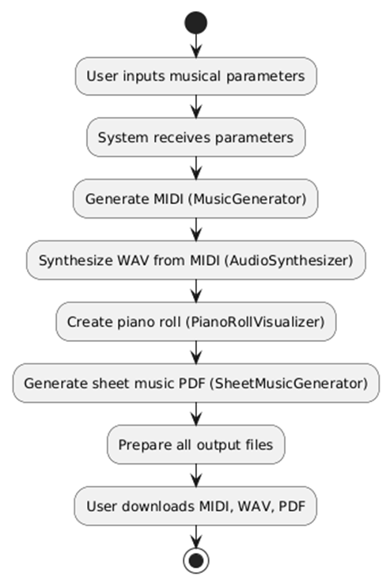
ACTIVITY
DIAGRAM

Slide 21
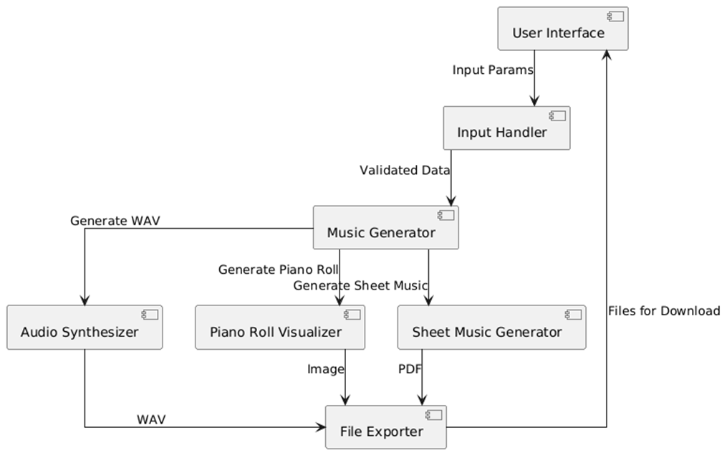
COMPONENT DIAGRAM

Slide 22
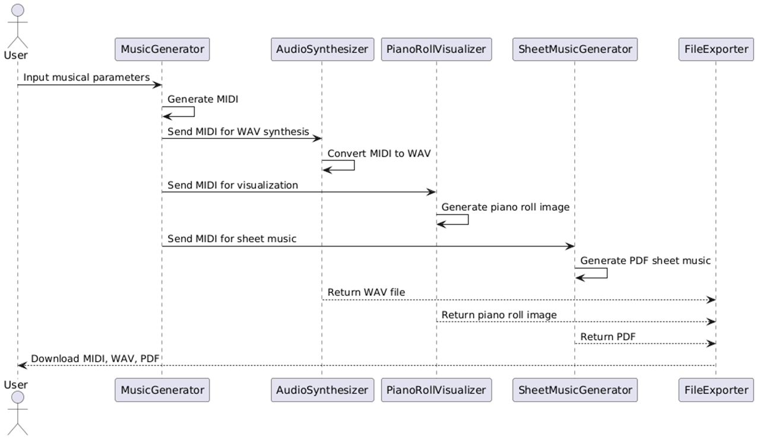
SEQUENCE DIAGRAM

Slide 23
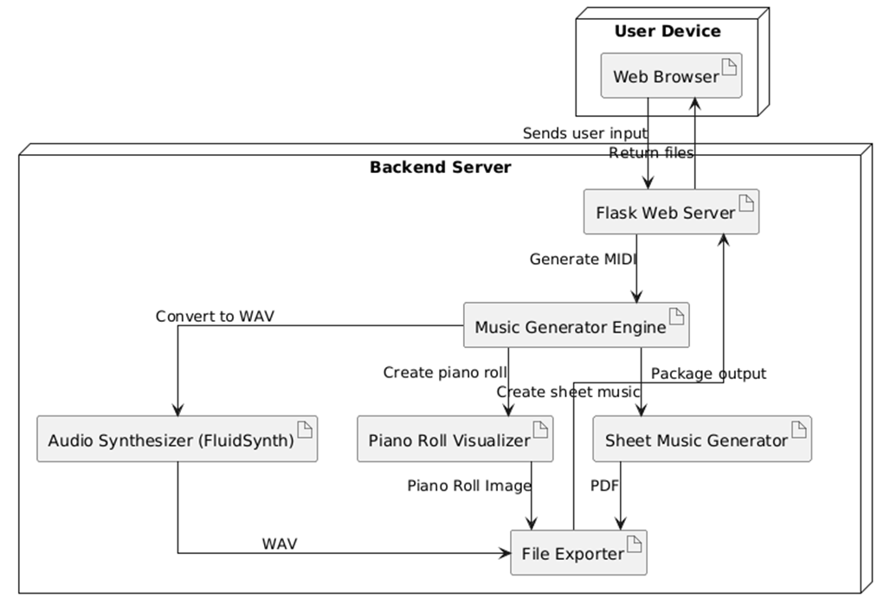
DEPLOYMENT DIAGRAM

Slide 24
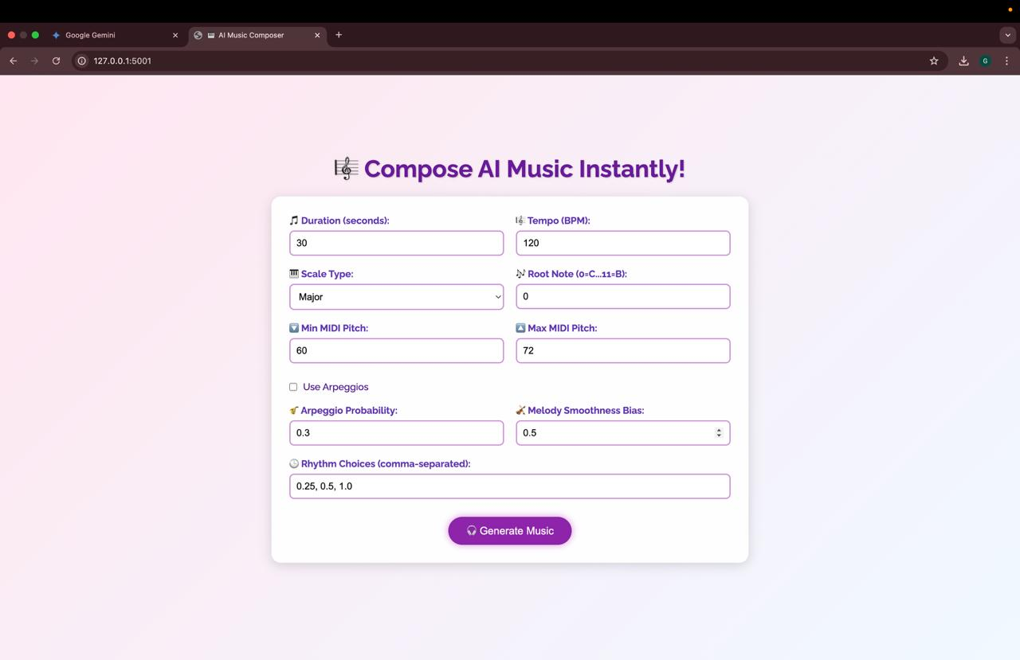
Figure 1: User Interface of AI Music Composer Web App

Slide 25
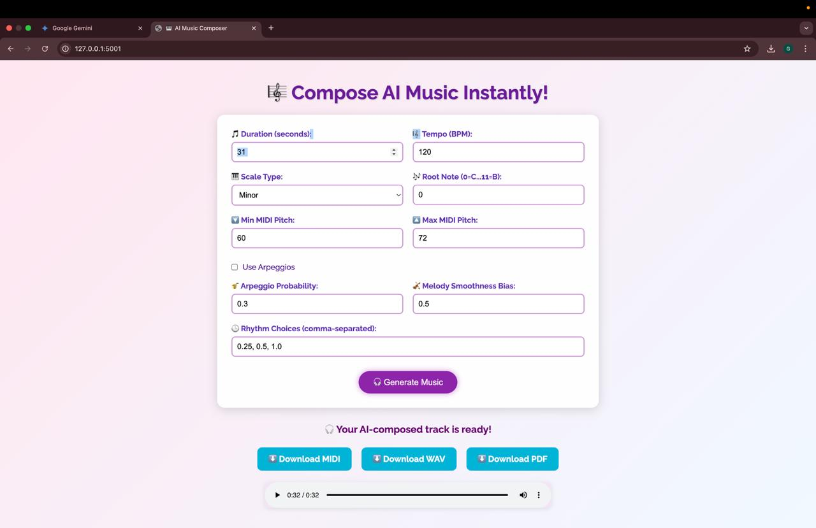
Figure 2: AI Music Composer – Output Ready Screen

Slide 26
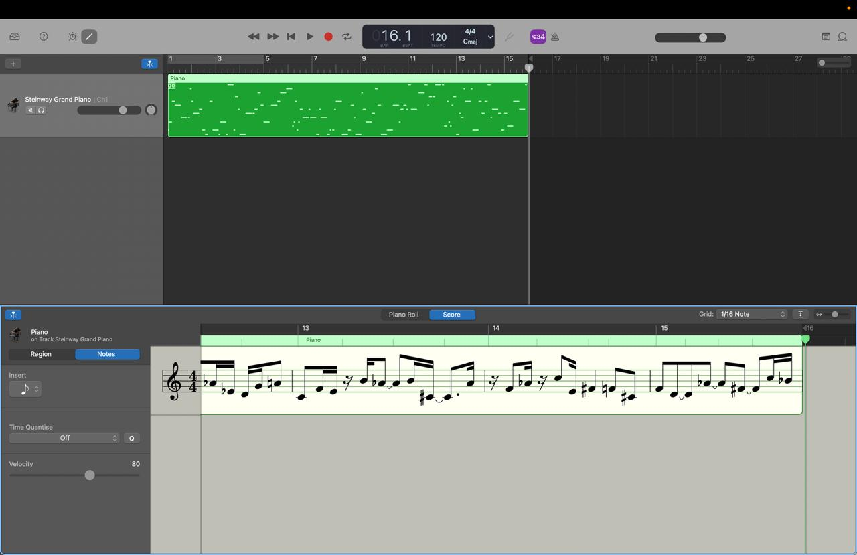
Figure 3: MIDI Score View in GarageBand

Slide 27
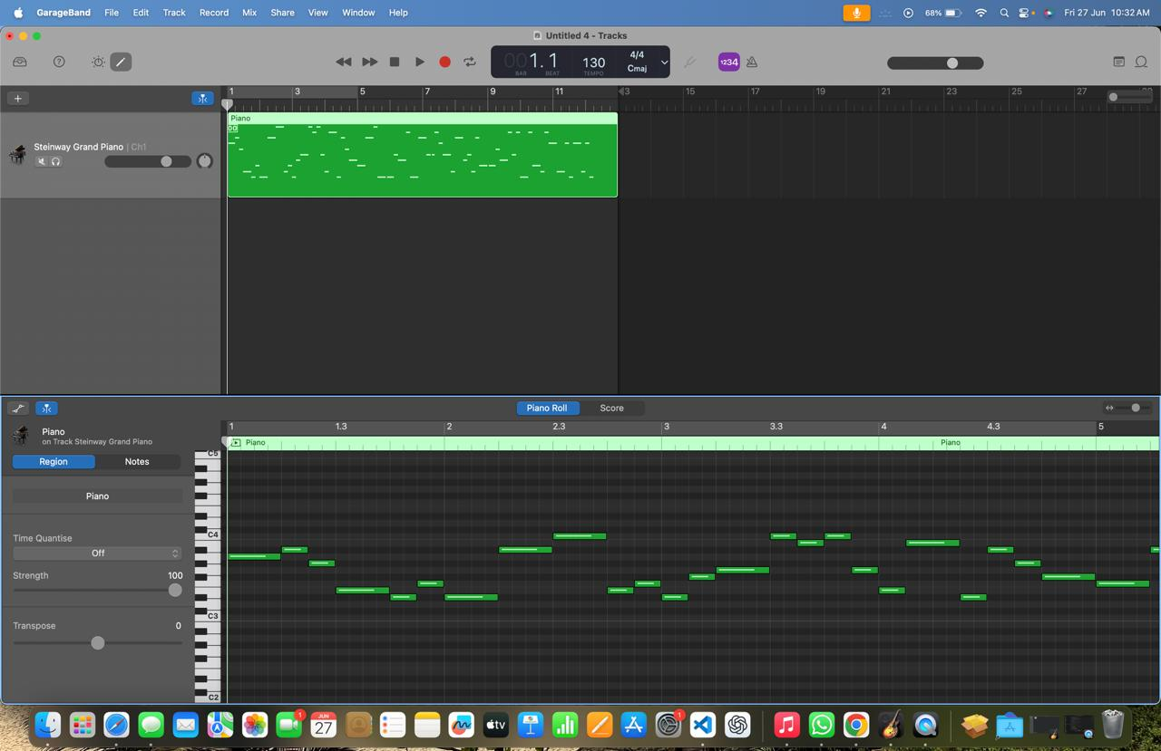
Figure 4: MIDI Piano Roll View in GarageBand

Slide 28
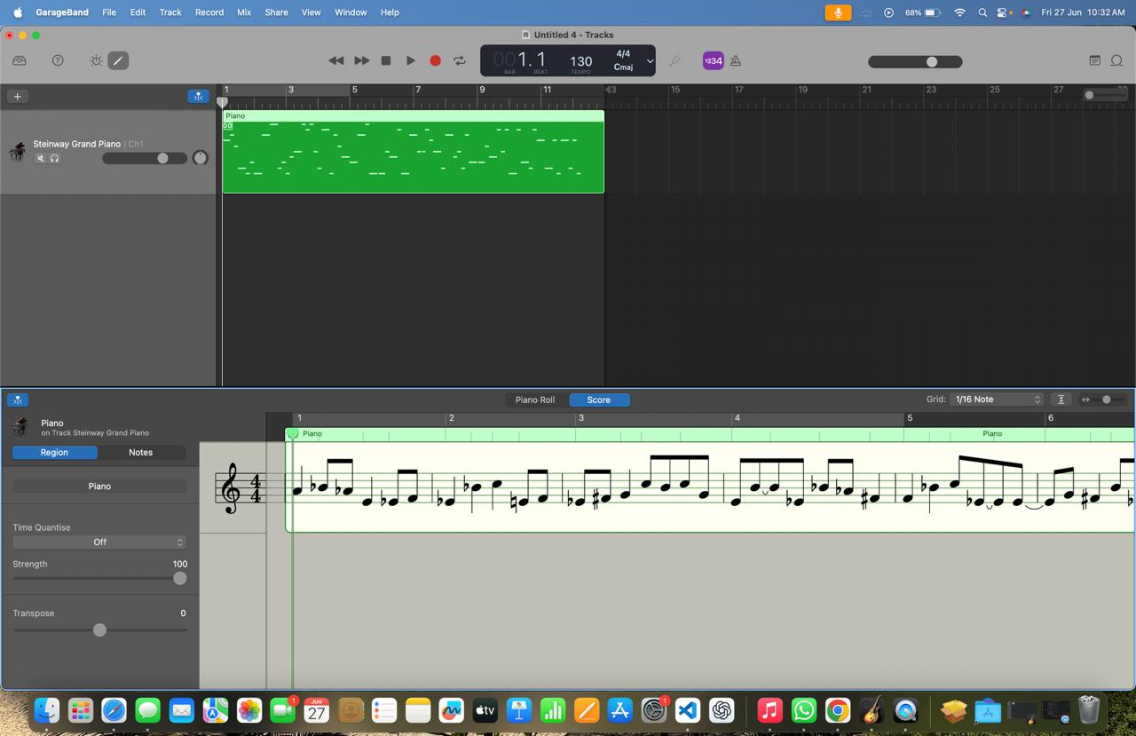
Figure 5: AI Music Sheet in Minor Scale (Score View)

Slide 29
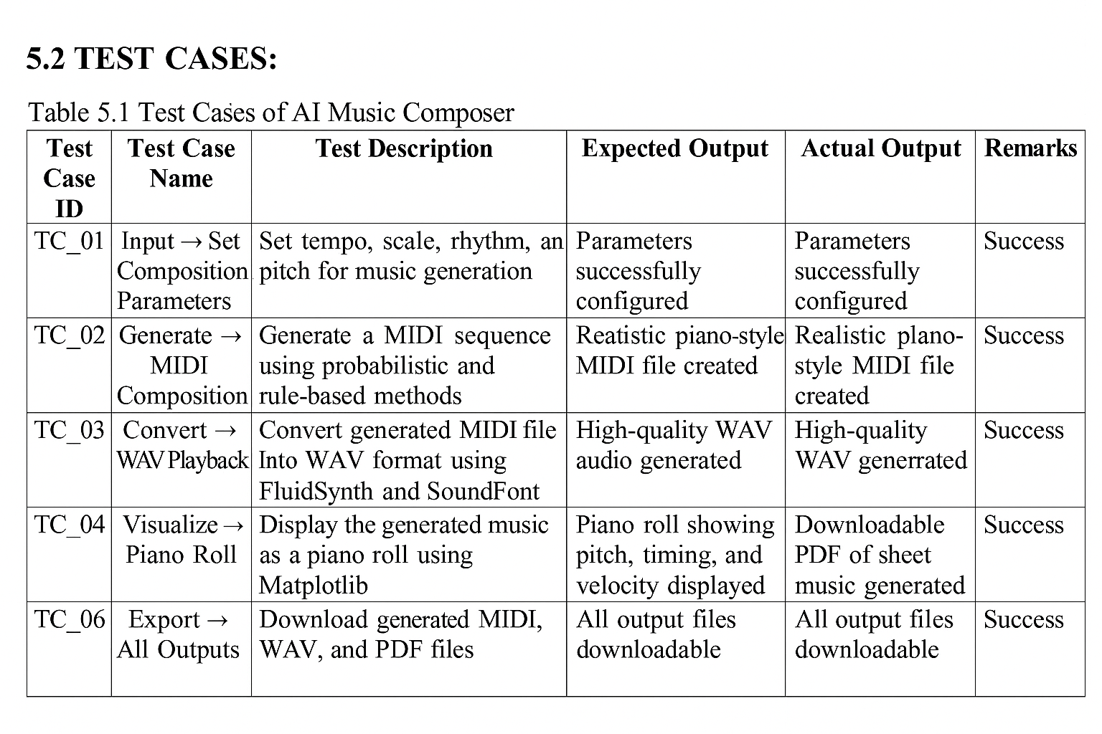

Slide 30
CONCLUSION AND FUTURE ENHANCEMENT
•The AI Music Composer simplifies music creation by using user inputs like tempo, scale, and rhythm to generate expressive piano compositions, even for users without formal training.
•It produces high-quality audio with FluidSynth and provides visual outputs like piano rolls and sheet music PDFs for better understanding and performance.
•Overall, it offers a complete end-to-end music generation system, useful for musicians, educators, and hobbyists. Future improvements could include more advanced AI for richer personalization.

Slide 31
Use deep learning (LSTM/Transformer) for advanced, varied music generation.
Add real-time editing for dynamic, instant composition.
Support multiple instruments beyond piano.
Enable user-customized music styles.
Improve visual tools like interactive piano rolls and waveform views.
Introduce cloud-based sharing and collaboration features.

Slide 32
REFERENCES
[1]. H.-W. Dong, W.-Y. Hsiao, L.-C. Yang and Y.-H. Yang, "MuseGAN: Multi-track GAN for symbolic music generation using MIDI representations," 2018 IEEE Transactions on Multimedia, pp.1–10, doi:10.1109/TMM.2018.2813798. Available: https://ieeexplore.ieee.org/document/8294203
[2]. G. Brunner, Y. Wang, R. Wattenhofer and S. Zhao, "MIDI-VAE: Modeling Dynamics and Instrumentation of Music with Applications to Style Transfer," IEEE Transactions on Multimedia, 2018, doi:10.1109/TMM.2018.2877824. Available: https://ieeexplore.ieee.org/document/8477248
[3]. P. Esling, A. Bitton and A. Chemla-Romeu-Santos, "FlowComposer: Constraint-based Symbolic Composition Tool with Visualization," 2020 IEEE Congress on Evolutionary Computation(CEC), Glasgow, UK, 2020, pp. 18, doi: 10.1109/CEC48606.2020.9185580.
Available: https://ieeexplore.ieee.org/document/9185580

Slide 33
[4]. Y.-S. Huang, S.-Y. Chou and Y.-H. Yang, "Pop Music Transformer: Beat-Based Modeling and Generation of Expressive Pop Piano Compositions," 2020 IEEE International Conference on Acoustics, Speech and Signal Processing (ICASSP), Barcelona, Spain, 2020, pp. 246–250, doi: 10.1109/ICASSP40776.2020.9053124. Available: https://ieeexplore.ieee.org/document/9053124
[5]. H. Choi, J. Kim and J. Nam, "Encoding Musical Style with Transformer Autoencoders," 2019 IEEE International Conference on Acoustics, Speech and Signal Processing (ICASSP), Brighton, UK, 2019, pp. 396–400, doi: 10.1109/ICASSP.2019.8683173. Available: https://ieeexplore.ieee.org/document/8683173

Slide 34
THANK YOU

